Slide 1
STEM MUN 2026
Annual Conference
HOW TO WRITE A WINNING POSITION PAPER
Step-by-Step Guide
“A Position Paper is your country’s voice before the debate begins.”
Shaden Roza

Slide 2
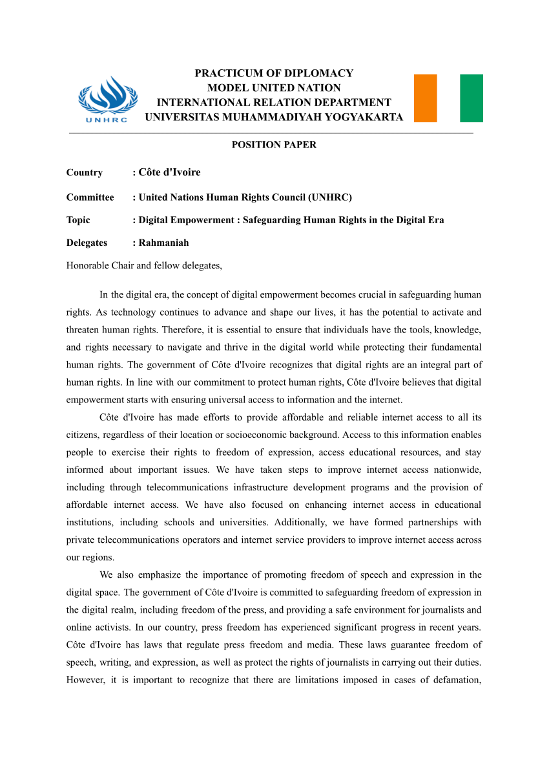
STEM MUN 2026
Annual Conference
What is a Position Paper?
A Position Paper is a formal document submitted before the conference that explains your country’s official position on the agenda.
Purpose:
  Demonstrate research and preparation
  Present your country’s policy
  Introduce realistic solutions
  Help Chairs evaluate your understanding

Slide 3
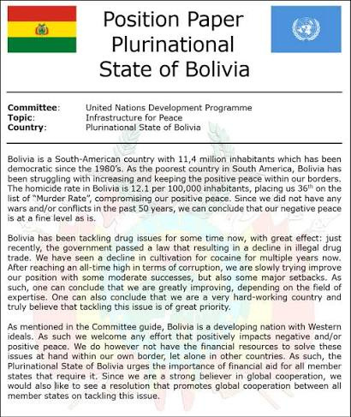
STEM MUN 2026
Annual Conference
Before You Start Writing
Every Position Paper begins with research.
Research Your Topic:
  Definition of the issue
  Historical background
  Current situation
  UN involvement
  Key stakeholders
Research Your Country:
  Official foreign policy
  Previous actions
  Alliances
  National interests
  Voting records

Slide 4
STEM MUN 2026
Annual Conference
Position Paper Structure
Every Position Paper follows the same structure:
  Header
  Background of the Issue
  Country’s Position
  Actions Taken
  Proposed Solutions
  References

Slide 5
STEM MUN 2026
Annual Conference
Part 1 – The Header
Include the following information:
  Country
  Committee
  Topic
  Delegate
Example
Country: Republic of Indonesia
Committee: United Nations Security Council
Topic: Preventing the Expansion of the Gaza War into a Regional Conflict
Delegate: Youssef Alaa Abd-Elhafiz

Slide 6
STEM MUN 2026
Annual Conference
Part 2 – Background of the Issue
Formula:
Problem ➜ Evidence ➜ Impact ➜ Importance
Purpose:
Explain the issue from a global perspective before discussing your country.
Include
✔ Definition of the problem
✔ Recent facts and statistics
✔ Humanitarian, political or economic impact
✔ Why this issue matters internationally
Example: Use the first section of the Indonesia Position Paper to show how the writer introduces the issue with facts, statistics, and credible sources.

Slide 7
STEM MUN 2026
Annual Conference
Part 3 – Country Position
Formula:
Country Policy ➜ National Interest ➜ Official Position ➜ Diplomatic Goals
Now answer:
What does YOUR country think?
Include:
  Official policy
  National interests
  Government statements
  Diplomatic priorities
Example: Highlight how Indonesia explains its support for Palestine and links it to its foreign policy.

Slide 8
STEM MUN 2026
Annual Conference
Part 4 – Actions Taken
This section answers:
What has your country already done?
Examples include:
  Signed treaties
  Voted on UN resolutions
  Hosted conferences
  Sent humanitarian aid
  Passed national policies
  Joined international initiatives
Example: Indonesia mentions diplomatic recognition, humanitarian aid, scholarships, and support for UN resolutions.

Slide 9
STEM MUN 2026
Annual Conference
Part 5 – Proposed Solutions
Your solutions should be:
✔ Realistic
✔ Relevant to your country’s policy
✔ Action-oriented
Start each solution with an action verb.
Examples:
Example: The Indonesia Position Paper proposes a ceasefire, humanitarian corridors, peacekeeping efforts, and reconstruction support.
  Establish
  Encourage
  Support
  Develop
  Create
  Promote
  Strengthen
  Deploy
  Provide
  Call upon

Slide 10
STEM MUN 2026
Annual Conference
Writing Style
Correct
✅ Egypt supports…
✅ The delegation of Brazil believes…
✅ France emphasizes…
✅ The Republic of Indonesia calls upon Member States…
Write from your country’s perspective.
ALWAYS USE THIRD PERSON.
Avoid
❌ I believe…
❌ We think…
❌ In my opinion…
❌ My country…
Remember:
You represent your country, not yourself.

Slide 11
STEM MUN 2026
Annual Conference
Use Diplomatic Language
Professional MUN vocabulary:
  Supports
  Encourages
  Reaffirms
  Recognizes
  Welcomes
  Calls Upon
  Emphasizes
  Recommends
  Advocates
  Affirms
  Expresses Concern
  Condemns (only if consistent with your country’s official policy)
  Urges
  Stresses

Slide 12
STEM MUN 2026
Annual Conference
References
Always use reliable sources.
Recommended Sources
  United Nations
  Ministry of Foreign Affairs
  Government Websites
  World Bank
  WHO
  Reuters
  AP News
  UN Digital Library
  Official Embassy Websites

Slide 13
STEM MUN 2026
Annual Conference
Common Mistakes
❌ Writing personal opinions
❌ Copy-pasting from AI
❌ Using unreliable sources
❌ Forgetting citations
❌ Proposing unrealistic solutions
❌ Ignoring your country’s official policy

Slide 14
STEM MUN 2026
Annual Conference
Position Paper Formula
Research the Topic ➜ Research Your Country ➜ Background of the Issue ➜ Country Position ➜ Actions Taken ➜ Proposed Solutions ➜ References

Slide 15
STEM MUN 2026
Annual Conference
THANK YOU!
ANY QUESTIONS?

